Slide 1
Bird Species Image Classification
Members: John
Khoa
Eddie
Boyu

Slide 2
Research Problem
Research Problem: Bird Species Image Classification
Goal | Methodology | Variability | Research focus
Build an AI model capable of accurately identifying bird species from diverse photos. | Establish Baselines: Develop custom CNNs from scratch to set performance benchmarks. | Images vary a lot in lighting, angle, and background, and the dataset is small and uneven. | Evaluate how pre-trained models compare to custom CNNs when dealing with complex, real-world images
Compare performance across four models. | Apply Transfer Learning: Implement pre-trained architectures to improve generalization and accuracy. | These variations make it difficult for AI to generalize to new bird photos. | Use these findings to improve accuracy and generalization for bird recognition tasks.
Notes:
"A quick reminder of our goal: distinguishing between visually similar bird species."
"The big update here is in our Methodology. We’ve expanded to four specific models:"
"First, a binary baseline to test the data."
"Second, a custom CNN to test the difficulty."
"And finally, ResNet50 and EfficientNet to solve the problem."

Slide 3
Dataset and Setup
Dataset | Setup | Metrics | Tools
Mercury is the closest planet to the Sun | Despite being red, Mars is a very cold place | Jupiter is a gas giant and the biggest planet | Venus is the second planet from the Sun
• Source: Kaggle Bird Species Classification Dataset. | • Trained using Google Colab | • Accuracy – overall model performance | • TensorFlow / Keras for model building
• Classes: 200 distinct bird species. | • Used train / validation / test splits | • Macro F1-Score – handles class imbalance | • NumPy / Matplotlib for analysis & plots
• Total Images: 11,788 images. | Training: 8,232 images(70%) Validation: 1,727 images (15%) Test: 1,829 images (15%) | • Confusion Matrix – shows prediction patterns | • Google Drive for dataset & results storage
Notes:
"We utilized the Kaggle Bird Species dataset containing about 12,000 images across 200 classes."
"We maintained a 70/15/15 split for training, validation, and testing."
"A key constraint here was the limited data per species, which really tested the ability of our models to generalize without overfitting."

Slide 4
Method 1: Baseline CNN (Bird vs Not Bird)
Overview
Results
Architecture: Developed a custom, lightweight Convolutional Neural Network (CNN) for binary classification.
Objective: Distinguish between images containing birds and those without, serving as a fundamental proof of concept.
High Performance: The model successfully learned basic object detection, achieving high accuracy in distinguishing birds from background noise.
Validation: Confirmed that the dataset images contained sufficient visual information for basic recognition tasks.
Notes:
Slide 4: Method 1 - Baseline CNN (Bird vs. Not Bird)
"Let's look at our results. Method 1 was our proof-of-concept: a Binary Classifier."
"We trained a lightweight custom CNN just to detect 'Bird vs. Not Bird'."
"The Result: It performed very well. This confirmed that the images themselves had enough clarity and information for a computer to recognize shapes and textures. However, distinguishing between species is a much harder task."

Slide 5
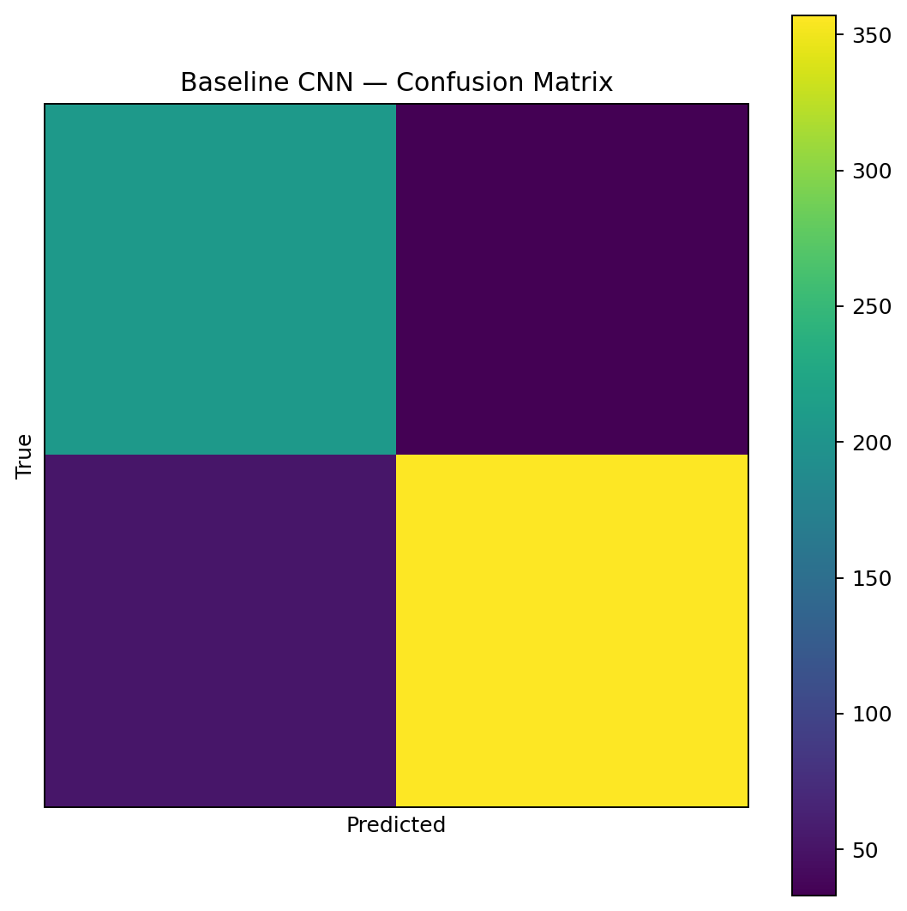
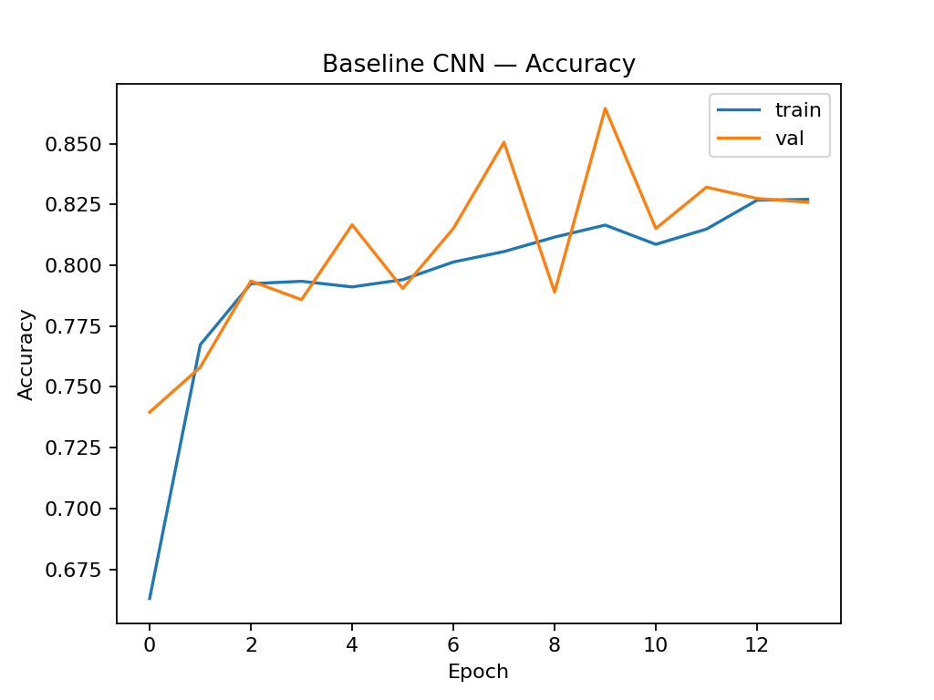
Baseline CNN (Bird vs Not Bird) Results
Venus
Venus has a beautiful name, but is also hot, even hotter than Mercury
Mars
Despite being red, Mars is a very cold place full of iron oxide dust
Notes:
"Graph Check: Look at the blue line—it shoots straight up. This simple graph tells us the model learned to find birds almost instantly."
"This confirmed our data was clean enough for basic detection, just not specific classification yet."
“Confusion Matrix: It has four different quadrant and show True Negative, False Positive, False Negative, and True Positive”

Slide 6
Method 2: Baseline CNN (Species Classification)
Overview
Results
Architecture: Extended the custom "Tiny CNN" to handle the full 200-class classification task.
Training: Trained from scratch on 224x224 RGB images without pre-trained weights.
Underfitting: Validation accuracy plateaued at approximately 4.5%.
Analysis: The simple architecture lacked the depth and complexity required to capture fine-grained features (like plumage patterns) across 200 distinct species.
Notes:
For Method 2, we used our custom baseline CNN and asked it to classify all 200 bird species. This model was very simple, we trained it completely from scratch. And because it had no pre-trained knowledge, it had to learn everything, like edges, colors, and textures, on its own. The goal was to see how far a small CNN could go on a challenging dataset with 200 classes.

Slide 7
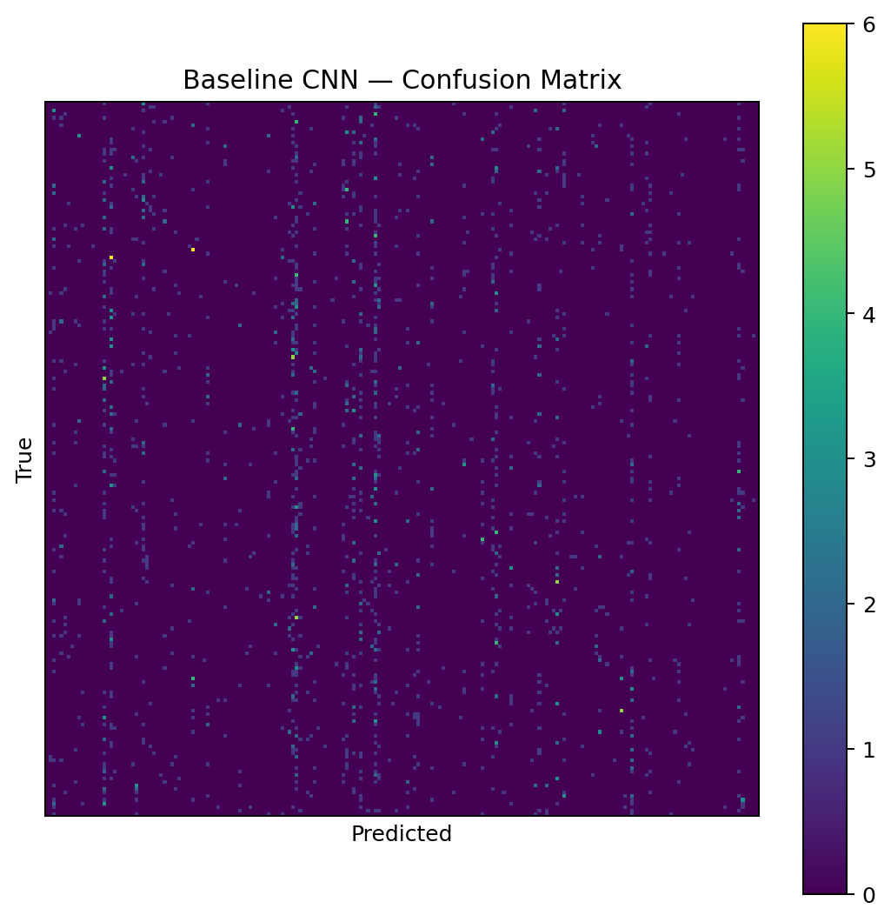
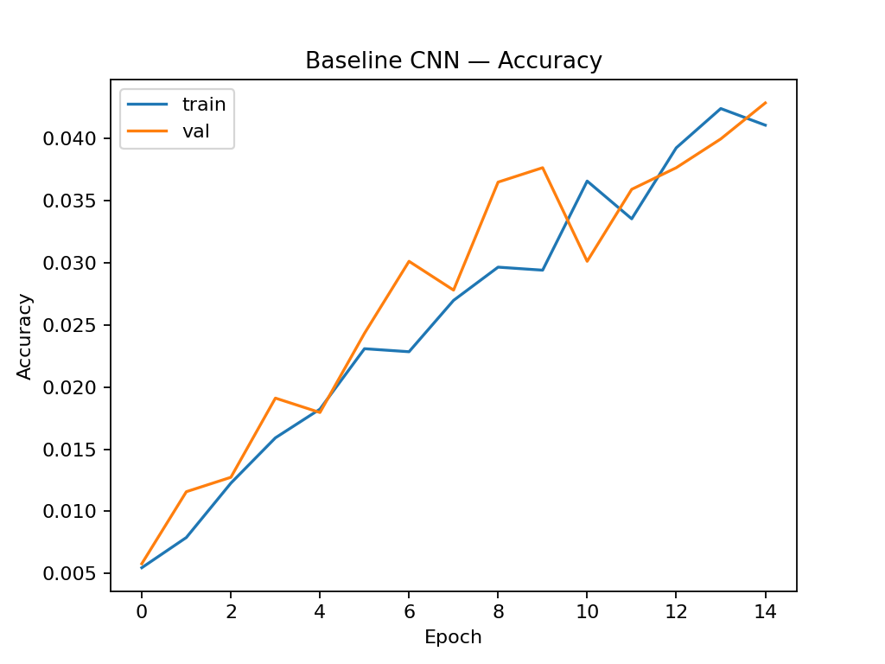
Baseline CNN (Species) Results
Venus
Venus has a beautiful name, but is also hot, even hotter than Mercury
Mars
Despite being red, Mars is a very cold place full of iron oxide dust
Notes:
This is where the model struggled. Our validation accuracy got stuck around 4–5%
That means the CNN wasn’t learning the differences between bird species. The reason is underfitting — the model was too simple "The model simply wasn't deep enough to learn the fine-grained features—like beak shape, feathers, or specific patterns from the bird images" And if you look at the confusion matrix on the right, it’s almost random — there’s no strong diagonal. Which means the model wasn’t recognizing meaningful patterns So overall, the baseline CNN gave us a starting point, but it wasn’t powerful enough for this dataset

Slide 8
Method 3: Transfer Learning (ResNet50)
Overview
Results
Model: Implemented ResNet50 pre-trained on ImageNet to leverage existing feature extraction capabilities.
Strategy: Froze initial layers to retain learned patterns (edges, textures) and fine-tuned the classification head for bird species.
Significant Improvement: Achieved much higher accuracy than the custom baseline by utilizing pre-learned visual features.
Efficiency: Reduced training time and improved convergence stability compared to training deep networks from scratch.
Notes:
Next, we moved on to Method 3: Transfer Learning with ResNet50 ResNet50 is a much deeper model that was already trained on millions of images.
So instead of learning from scratch, it already knows how to detect textures, shapes, and edges.” “We used ResNet50’s pre-trained knowledge as a base and added our own layer for bird species. Then we fine-tuned it so it learns bird-specific details. Basically, instead of training from zero, we start with a model that already knows what to do.

Slide 9
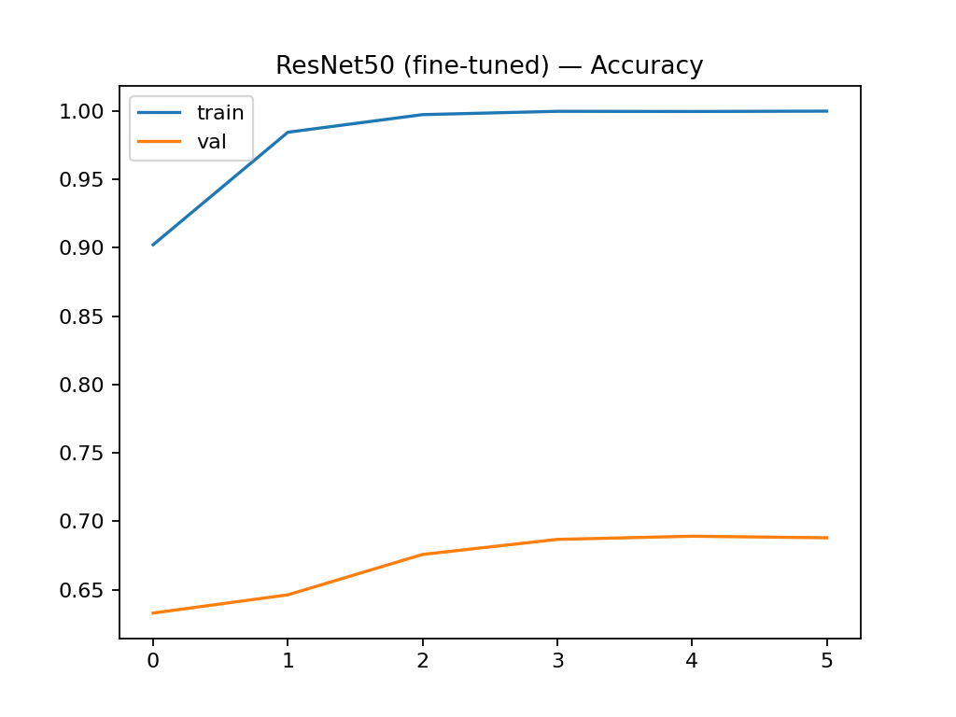
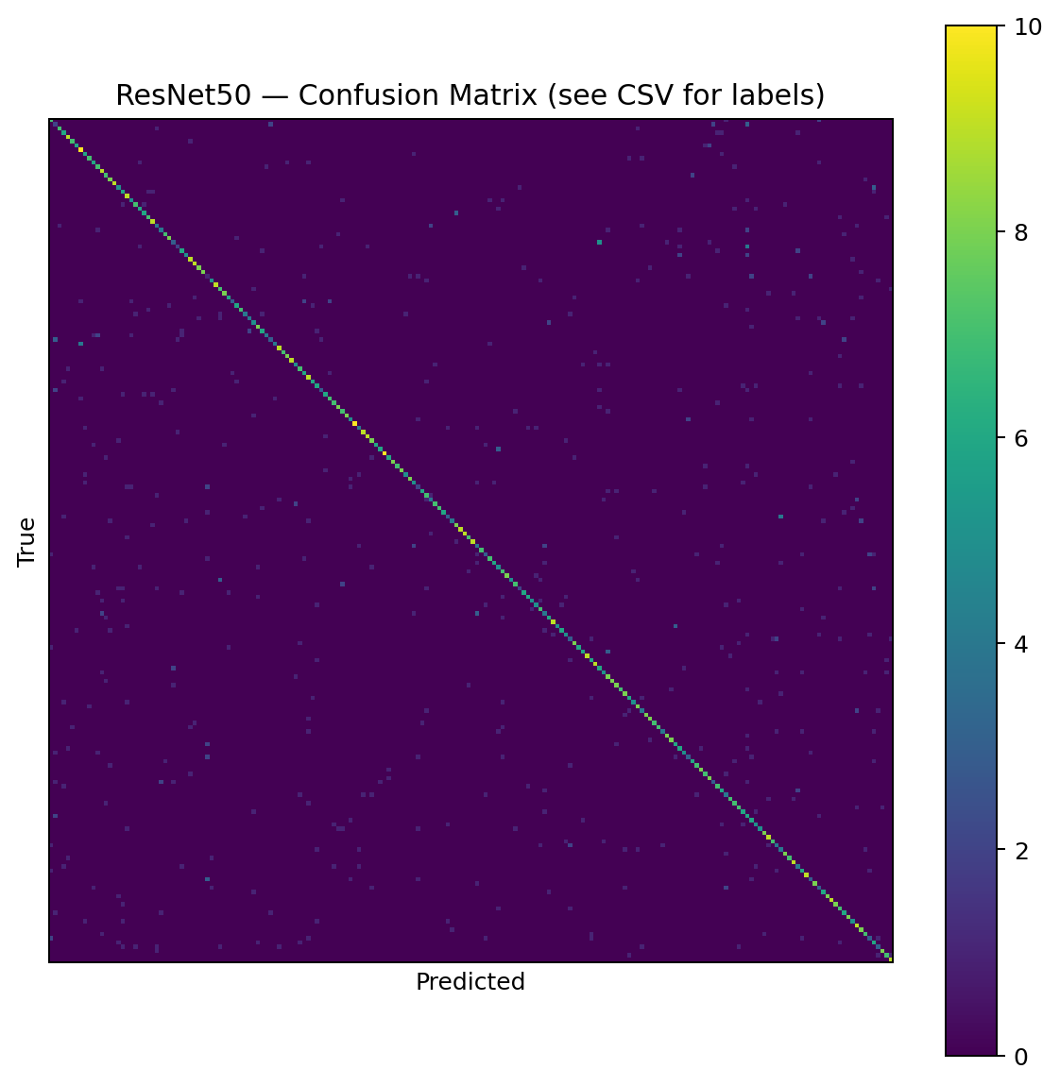
ResNet50 Results
Notes:
ResNet50 performed much better than our baseline CNN. Even on the first epoch, accuracy jumped way higher than our baseline CNN. After fine-tuning, the validation accuracy reached around 65–70%, which is a huge improvement compared to 4%.”
On the confusion matrix, you can now see a strong diagonal — this shows the model is correctly identifying many species. ResNet50 still struggles with some species that look similar. But overall it learned much better patterns due to it being pre trained.

Slide 10
Method 4: Transfer Learning (EfficientNet)
Overview
Results
Model: Deployed EfficientNet, utilizing "Compound Scaling" to balance network depth, width, and resolution.
Goal: Maximize classification accuracy while minimizing computational cost and model parameter size.
Top Performance: Delivered the best balance of speed and accuracy among all tested models.
Key Finding: Proved highly effective at distinguishing subtle inter-species differences (e.g., beak shape) that simpler models missed.
Notes:
"Finally, this is our Method number 4: EfficientNet."
"EfficientNet uses 'Compound Scaling' to balance depth, width, and resolution."
"The Result: This was our top performer. It distinguished between subtle differences much better than the custom model and achieved a better balance of speed and accuracy compared to ResNet."

Slide 11
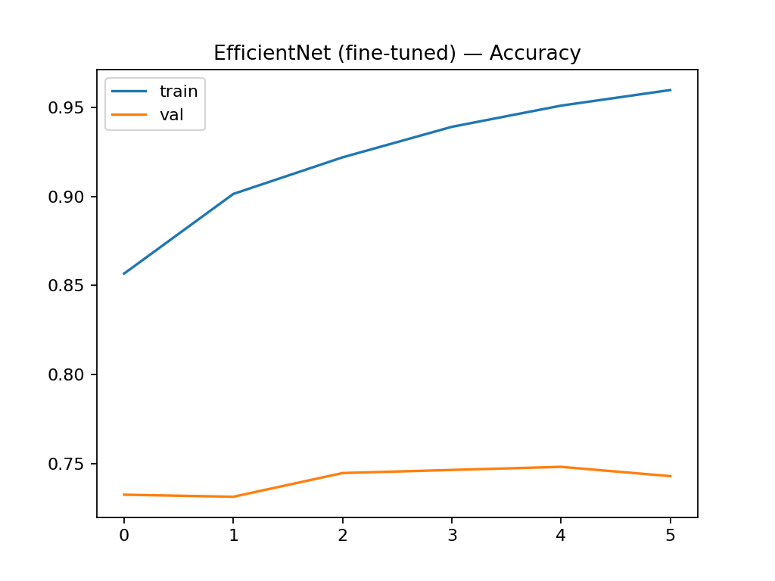

Transfer Learning + EfficientNet Results
Notes:
"Graph Check: The curve here is similar to ResNet—very high and stable—but this model is much lighter and faster."
"The confusion matrix here shows a much stronger diagonal line, indicating correct predictions across the diverse species."
"The confusion matrix on the right is the cleanest one we have, meaning it made the fewest mistakes between similar-looking birds."

Slide 12
Challenges
The dataset is relatively small and contains high variability in lighting, backgrounds, and angles, making generalization difficult.
Limited & poor quality of data
Distinguishing between 200 visually similar species requires capturing minute details, such as beak shape or plumage patterns, that simpler models miss.
Fine-Grained Classification
The uneven distribution of images across different species can cause the model to bias its predictions toward the more common birds.
Class Imbalance
High capacity models like ResNet50 are prone to memorizing the small training set, requiring careful regularization like dropout and early stopping.
Overfitting Risks
Notes:
"Throughout this process, we navigated four main challenges:"
"Limited Data: The dataset was small relative to the complexity of the task."
"Fine-Grained Classification: Distinguishing between 200 similar birds requires capturing minute details that simple models miss."
"Class Imbalance: Some birds appeared more often, biasing the training."
"Overfitting: The powerful models (ResNet/EfficientNet) tried to memorize the data, requiring us to implement early stopping and dropout layers."

Slide 13
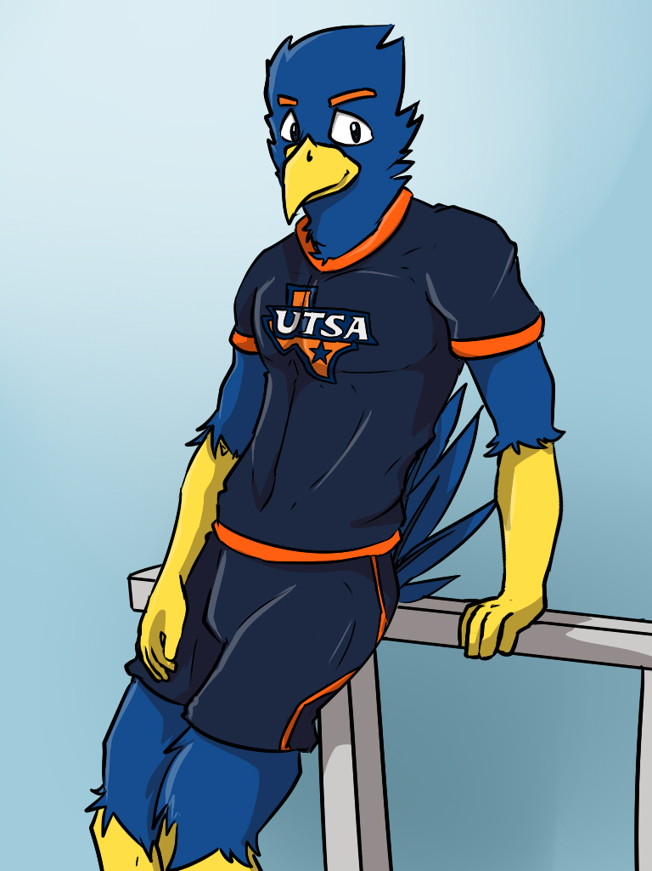
DEMO TIME

Slide 14
References
He, K., Zhang, X., Ren, S., & Sun, J. (2016). Deep residual learning for image recognition. In Proceedings of the IEEE Conference on Computer Vision and Pattern Recognition (CVPR) (pp. 770–778).
Alswaitti, M., Zihao, L., Alomoush, W., Alrosan, A., & Alissa, K. (2022, March). Effective classification of Birds’ species based on transfer learning. International Journal of Electrical and Computer Engineering (IJECE).
Kumar, Akash. “Bird Species Classification.” Kaggle, 30 Sept. 2018, www.kaggle.com/datasets/akash2907/bird-species-classification.
Sarwar, Muhammad Saood. “Drone vs Bird:Aerial Object Classification Dataset.” Kaggle, 1 Mar. 2025, www.kaggle.com/datasets/muhammadsaoodsarwar/drone-vs-bird.
Banerjee, Sourav. “Animal Image Dataset (90 Different Animals).” Kaggle, 17 July 2022,www.kaggle.com/datasets/iamsouravbanerjee/animal-image-dataset-90-different-animals.

